Slide 1

Deep Learning and Applications SDL Presentation Topic: Understanding XceptionNet Under the guidance of Dr. Siddalinga Swamy P. C.
Team Members
230913003 Pasupuleti Rohithsaidatta
230913004 Amit Kumar
230913025 Aston Dsouza
230913021 Prajwal Purushotham Varekar
230913017 Abhay S Gad
230913026 Akshay C

Slide 2

Contents
Introduction
Xception Net Architecture
Standard Convolution vs Depthwise Separable Convolution
Xception Net Working (Depthwise Separable Convolution + Pointwise Convolution)
Advantages & Disadvantages
Applications

Slide 3
Introduction
Introduction:
- Xception is an advanced version of the Inception model, specialized in image recognition.
Previous Successes:
- Inception models like V1, V2, and V3 were successful in understanding images before Xception.
Effective Parameter Usage:
- Xception achieves superior results by utilizing its parameters more effectively, rather than simply increasing them.
Performance:
- Xception surpasses Inception V3 on ImageNet and exhibits remarkable progress on larger datasets.
Innovative Approaches:
- Xception extends the Inception concept by treating color/features and shape separately, using separable convolution to enhance learning efficiency.

Slide 4
Xception vs. Traditional Architectures
Xception is more complicated and deeper than VGGNet and ResNet.
Because of this complexity, it's harder to train and use Xception, especially in places with limited resources.
Xception needs a lot of computing power, so it's not great for devices or systems that don't have much power.
Training Xception models takes a long time because of how complex they are.
The time it takes to train Xception models can be an issue for tasks that need to be done quickly or in real-time.

Slide 5
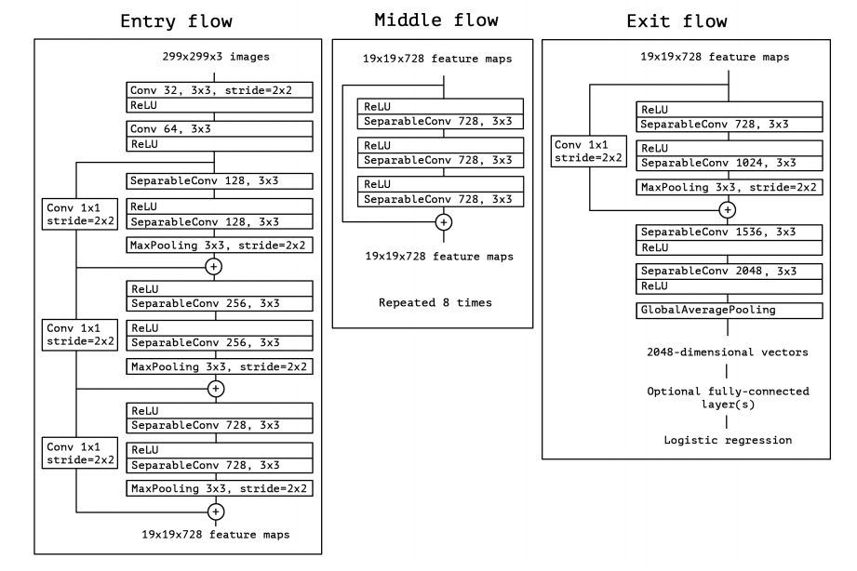
Xception Net Architecture
The data first goes through the entry flow, then through the middle flow which is repeated eight times, and finally through the exit flow. Note that all Convolution and SeparableConvolution layers are followed by batch normalization.

Slide 6
Standard Convolution vs Depthwise Separable Convolution
Standard Convolution involves sliding a filter/kernel over the input image, computing the dot product between the filter and the input at each position.
This operation involves three dimensions: width, height, and depth (number of channels). The filter slides across all these dimensions.
It is computationally expensive, especially for deep networks with many layers, as it involves a large number of computations.
It is represented as a single operation, where the entire filter is applied to all input channels.

Slide 7
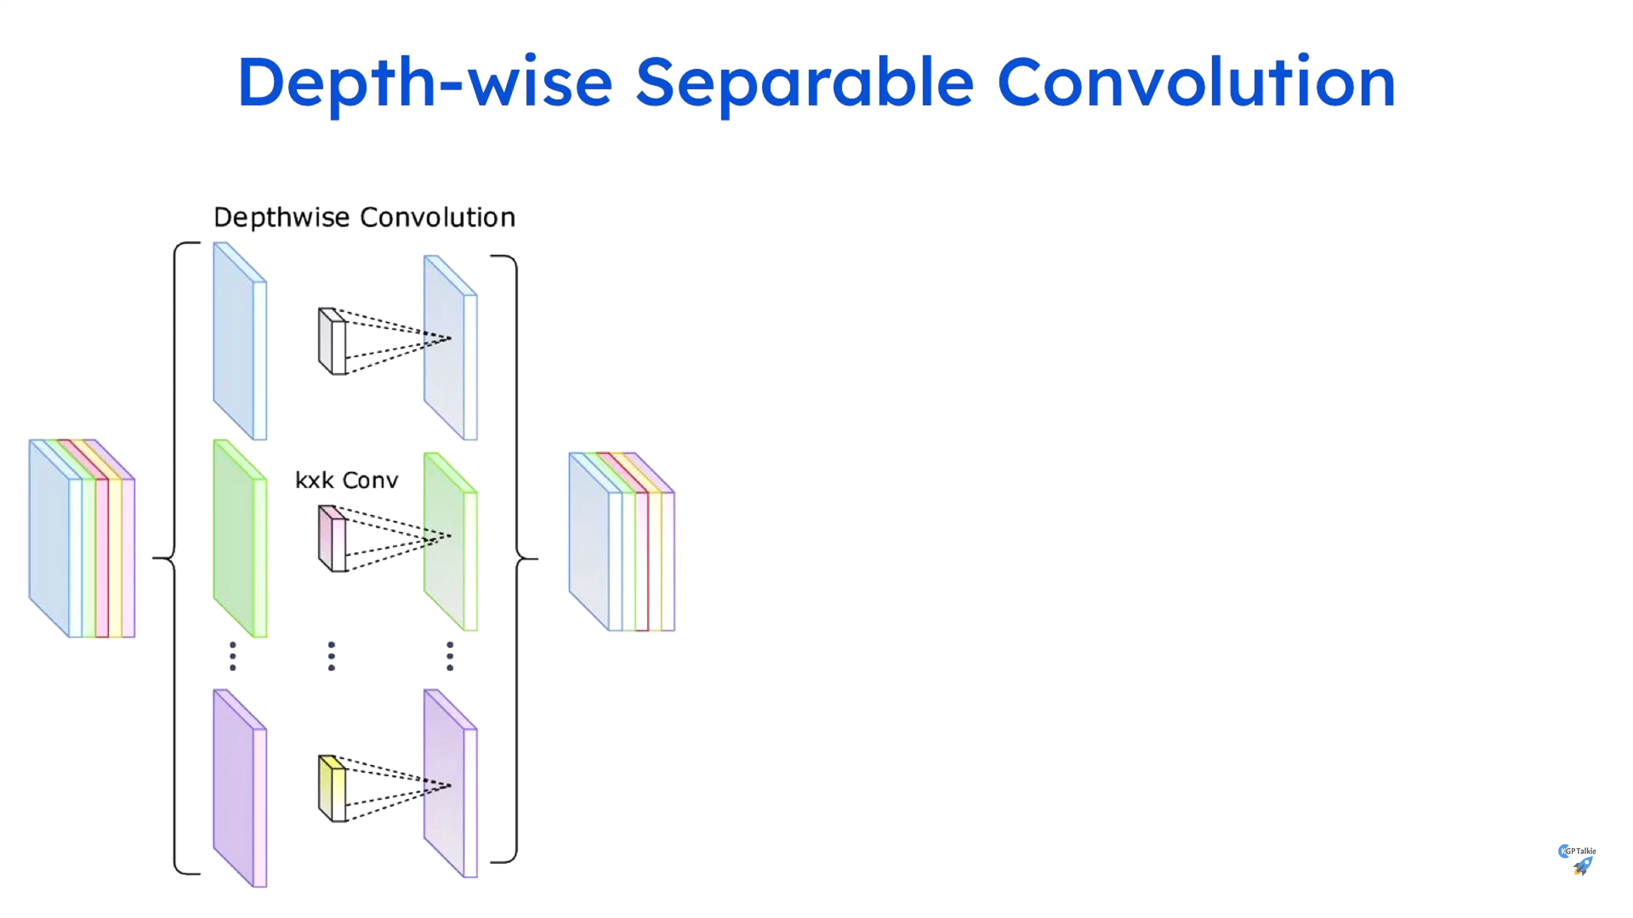
Standard Convolution vs Depthwise Separable Convolution

Slide 8
Standard Convolution vs Depthwise Separable Convolution
Depthwise Separable Convolution decomposes the standard convolution into two separate operations: depthwise convolution and pointwise convolution.
In depthwise convolution, each input channel is convolved separately with its own set of filters. This operation captures spatial patterns within each channel independently.
Depthwise separable convolution reduces the computational cost significantly compared to simple convolution because it involves fewer parameters and computations.

Slide 9
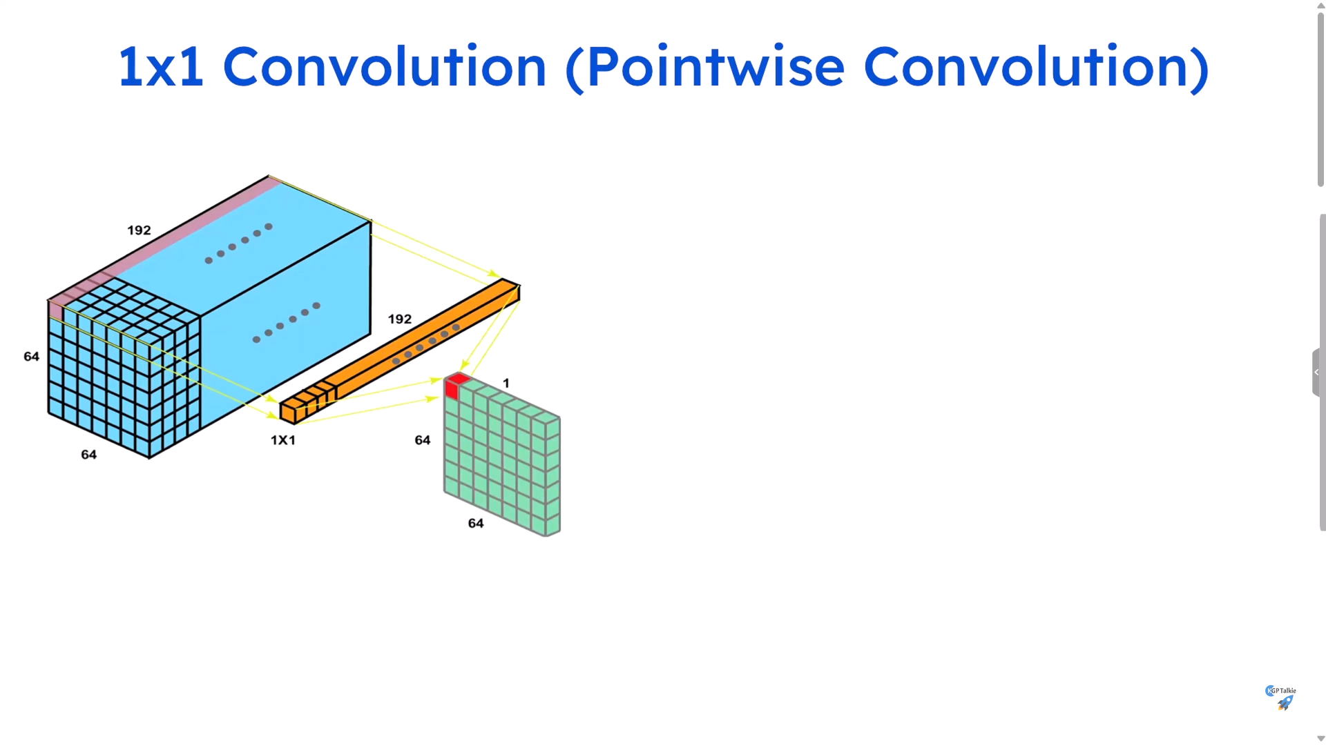
Xception Net Working (Depthwise Separable Convolution + Pointwise Convolution)
In pointwise convolution, a 1x1 convolution is applied across all input channels. This operation combines the outputs of the depthwise convolution and allows cross-channel interaction.

Slide 10
Xception Net Working (Depthwise Separable Convolution + Pointwise Convolution)
Pointwise Convolution
After Depthwise Convolution: Pointwise convolution is applied after the depthwise convolution stage.
1x1 Convolution: It involves using a 1x1 convolutional kernel.
Combining Output Channels: Pointwise convolution combines the output channels produced by the depthwise convolution into the final output.
Linear Combination: Each output channel is formed by taking a linear combination of all the input channels.
Determines Output Depth: The number of output channels (determined by the number of 1x1 filters used) decides the depth of the output volume.

Slide 11
Advantages & Disadvantages.
Reduced Parameters
Xception's use of depth wise separable convolutions significantly reduces the number of parameters, leading to improved computational efficiency and reduced memory footprint.
Enhanced Performance
The architecture's efficiency does not compromise performance, as it has demonstrated state-of-the-art results on various image classification and object recognition benchmarks.
Scalability
Xception's computational efficiency makes it scalable to different hardware platforms and deployment environments, offering versatility in application.

Slide 12

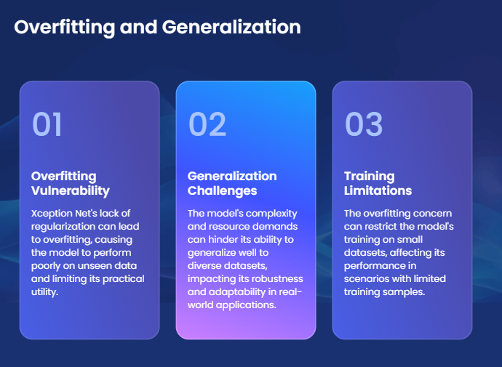
Advantages & Disadvantages
Disadvantages

Slide 13
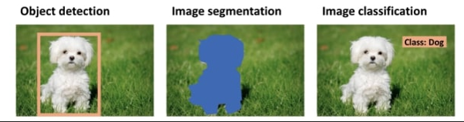

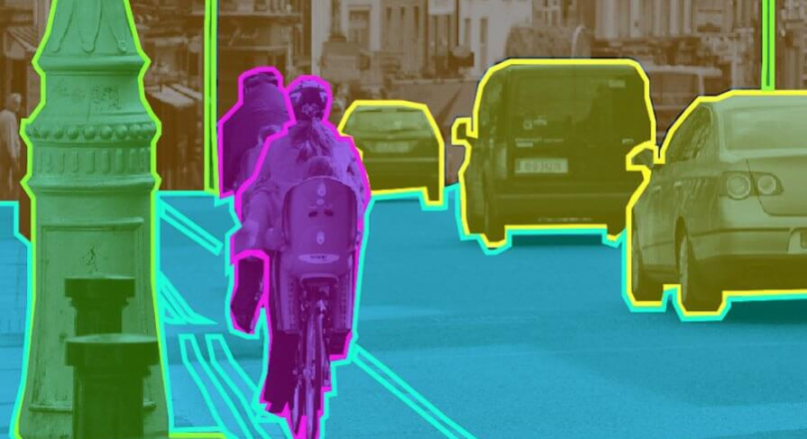
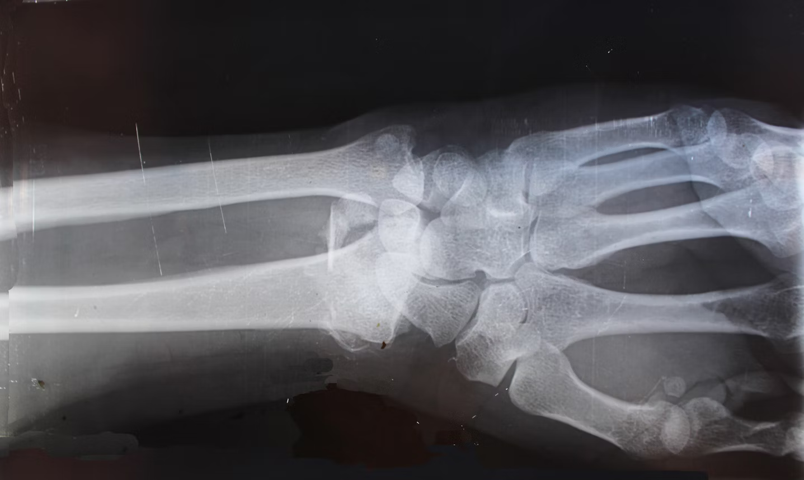
Applications

Slide 14
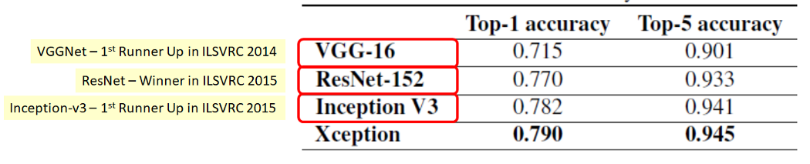
Comparison of ImageNet: Xception Model with other Models

Slide 15
Thank You ☺

